Slide 1
OOP & data struct 14. Graph
By Somsin Thongkrairat

Slide 2
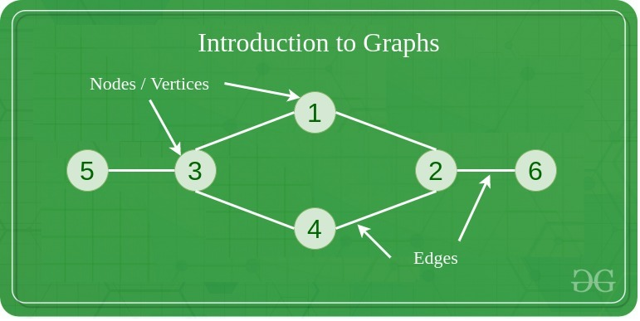
Graph
https://www.geeksforgeeks.org/graph-data-structure-and-algorithms/

Slide 3
Graph
- fundamental non-linear data structure consisting of node(vertex) and path(edge)
- node(vertex) is an item or element in structure
- path(edge) is the information that how each node connected
- เป็น structure พื้นฐานแบบ non-linear ที่ประกอบไปด้วย node(vertex) และ path(edge)
- node(vertex) คือ item หรือ element ใน structure
- path(edge) คือข้อมูลที่บอกว่าแต่ละ node เชื่อต่อกันอย่างไร

Slide 4
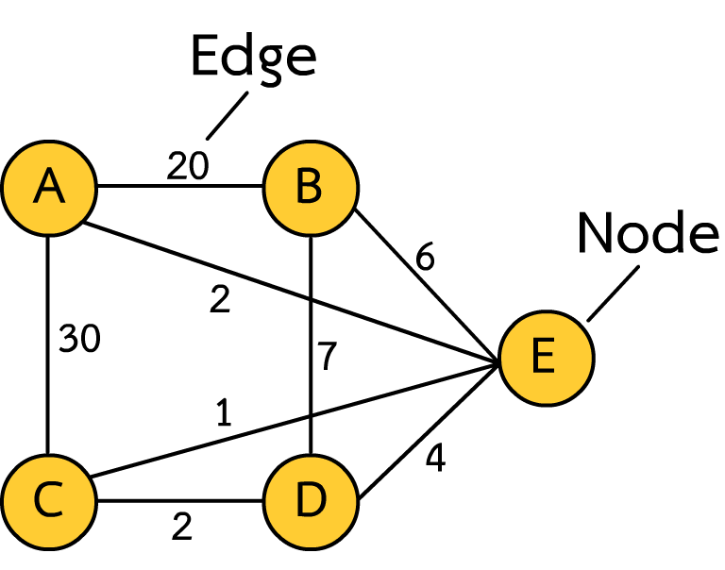
Component of graph
- Node contain data object
- Edge contain travel cost between node
- Node เก็บข้อมูลของแต่ละ object
- Edge เก็บ cost ของการเดินทางระหว่าง node

Slide 5
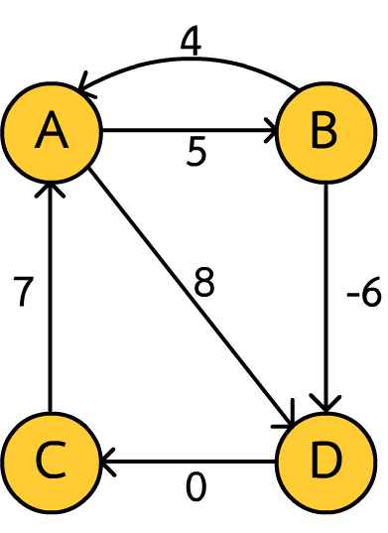
type of graph
- There are several type of graph classified by rule
- graph มีหลายชนิดจัดประเภทตามกฎ
Direct / undirect
Non-negative edge / floating point edge
Cyclic graph / Acyclic graph

Slide 6
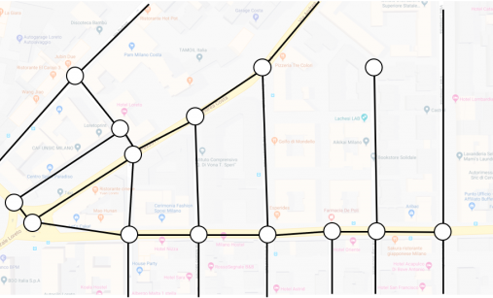

Depend on purpose
https://dreamcivil.com/systems-of-plumbing/
https://junkee.com/google-maps-has-been-tracking-your-every-move-and-theres-a-website-to-prove-it/39639

Slide 7

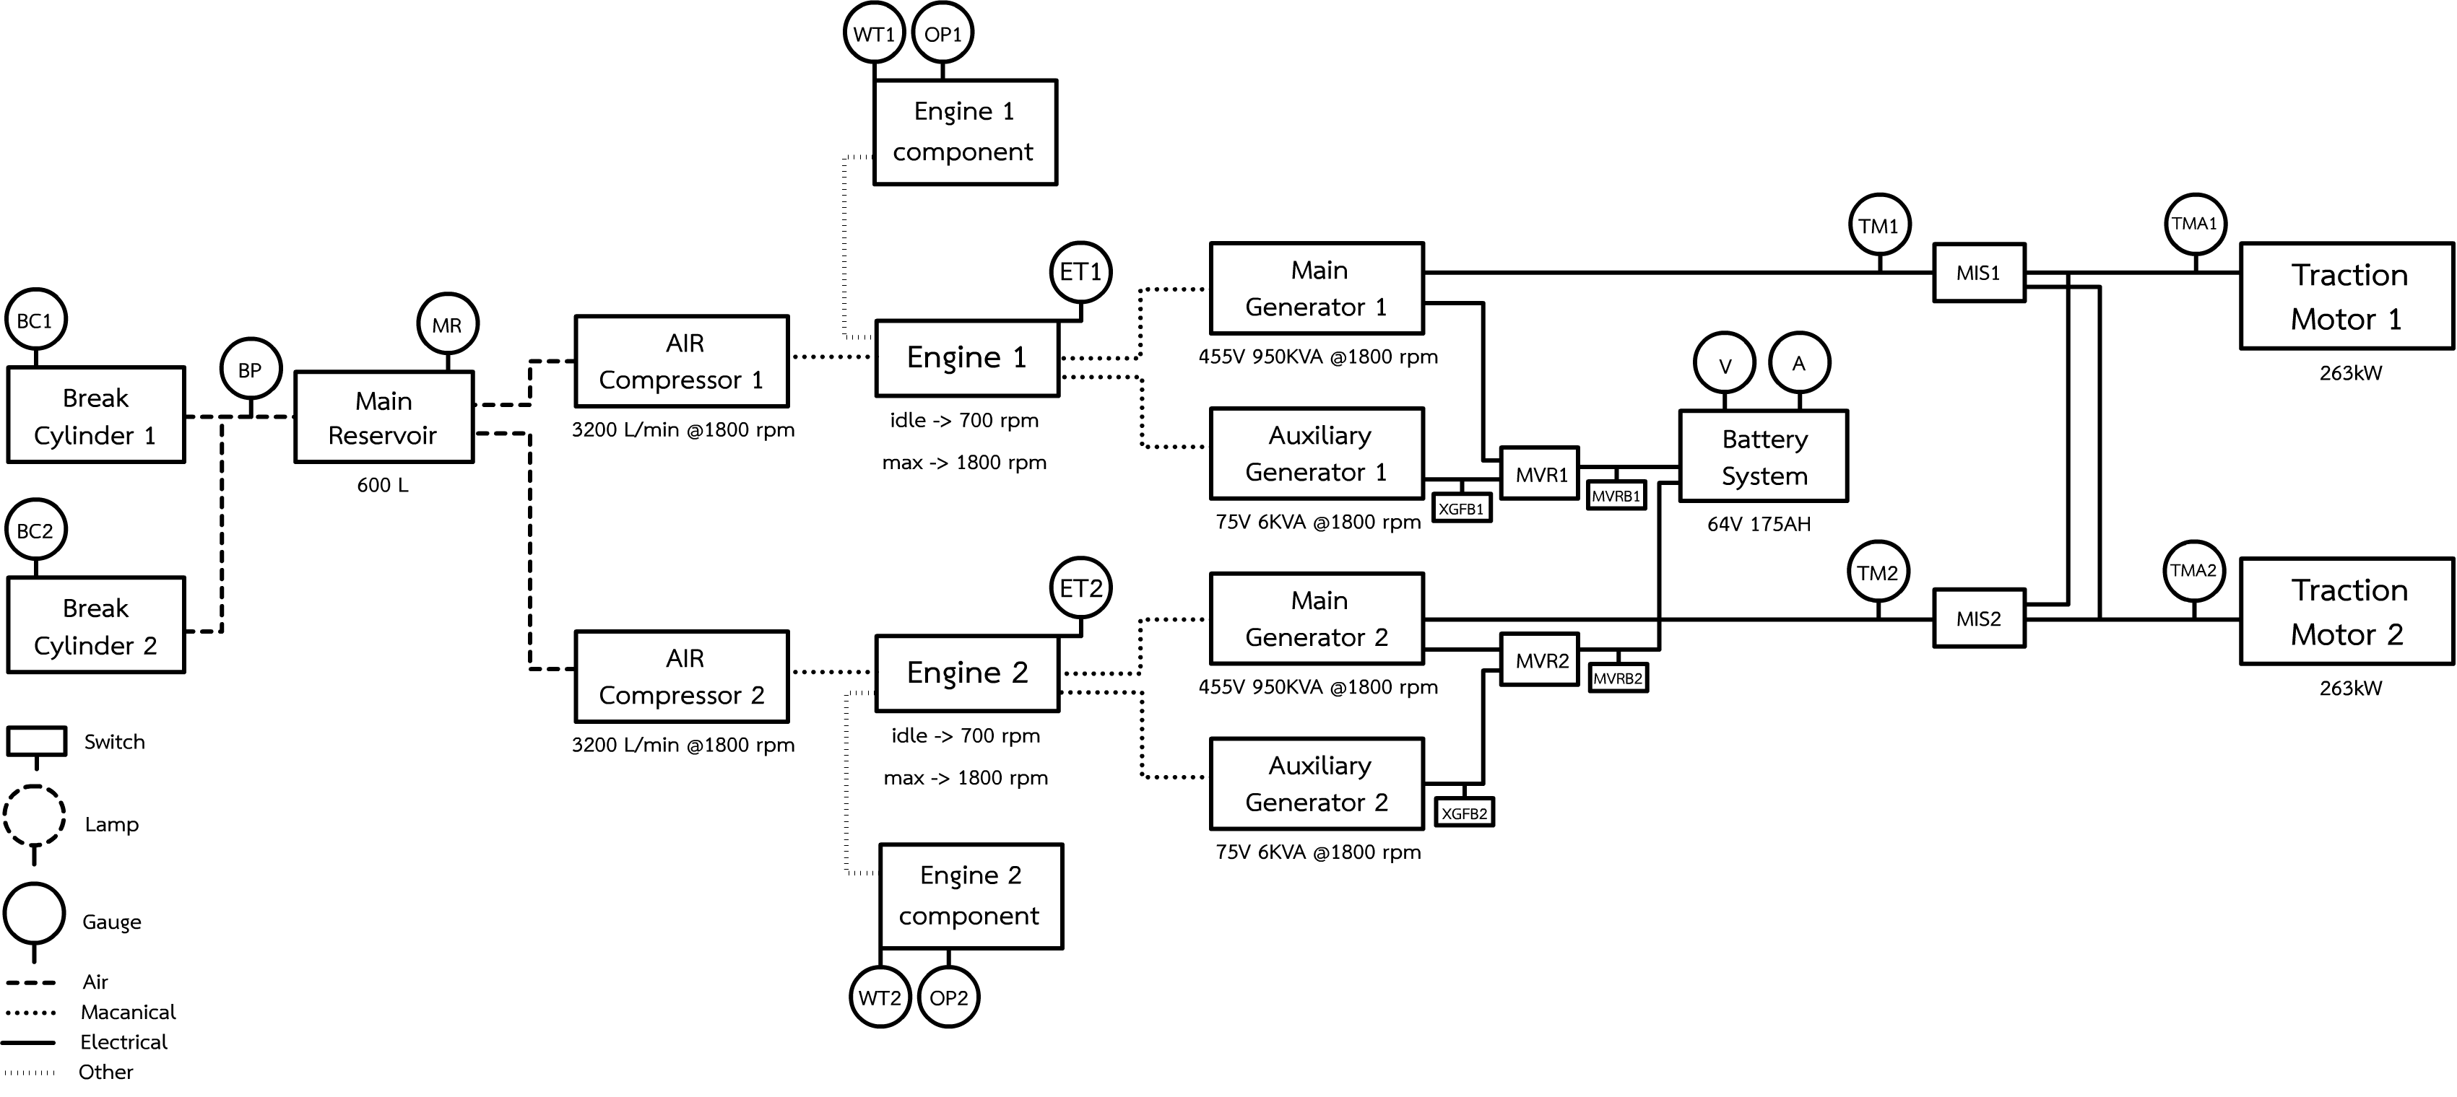
Depend on purpose

Slide 8
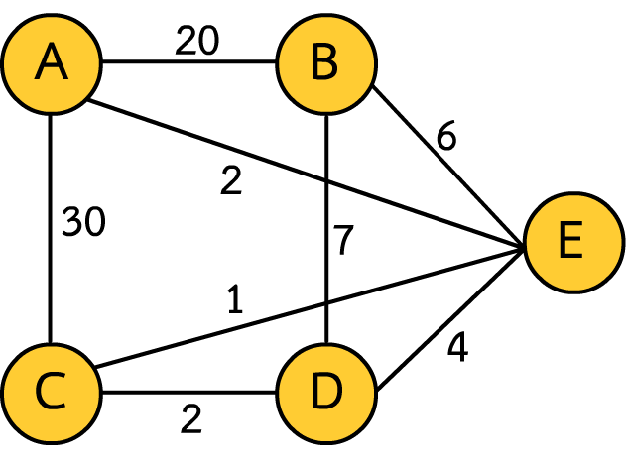
Our scope
- Non-negative edge undirected cyclicable graph
Edge can’t be negative cost
All edge can use any direction to travel
แต่ละ edge จะไม่มี cost ที่ติดลบ
ทุก edge ใช้เส้นทางใดก็ได้

Slide 9
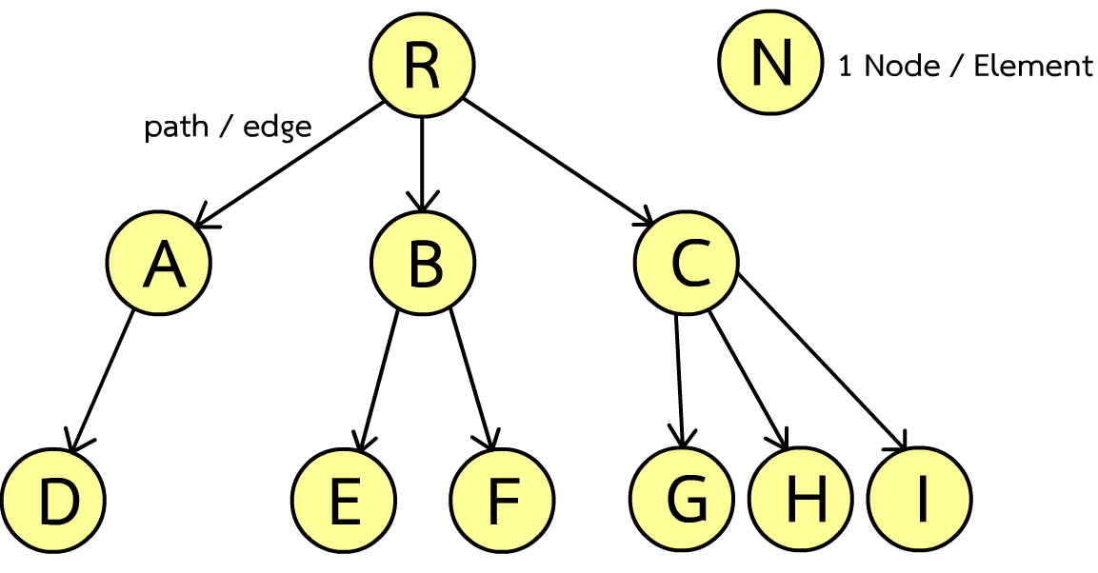
Before we start
- Tree is subset of graphs with restricted rule, So tree always a graph but not all graph will be tree
- Tree เป็น subset ของ graph ที่มีกฎของตัวเอง ดังนั้น tree ทุกตัวจะเป็น graph แต่ไม่ใช่ว่า graph ทุกตัวจะเป็น tree

Slide 10
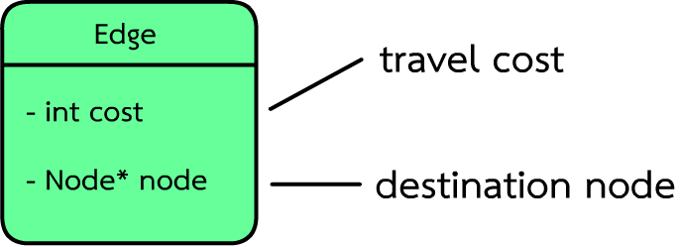
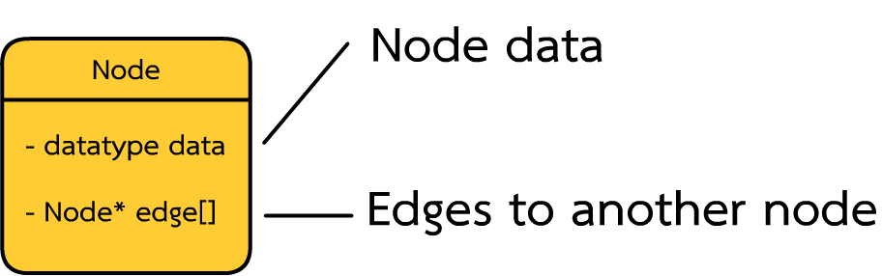
Data structure object base graph (node & edge)

Slide 11
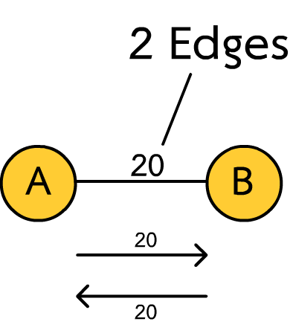
Edge (undirected graph)
class Edge{
public :
int cost;
Node* node;
Edge(int _cost,Node* dest){
cost = _cost;
node = dest;
}
};

Slide 12
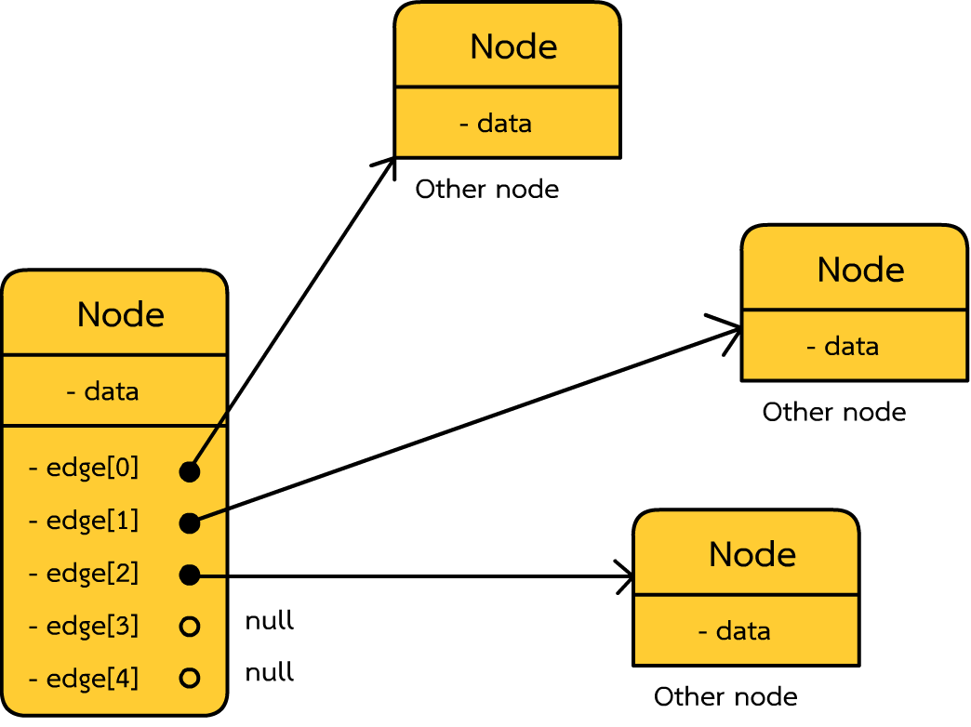
Code (fixed node number)
class Node{
public :
char data;
int edge_count;
Edge* edges[5]; Node(char item){
data = item;
edge_count = 0;
} void add_edge(int cost,Node* n){
edges[edge_count] = new Edge(cost,n);
edge_count++;
}
};

Slide 13
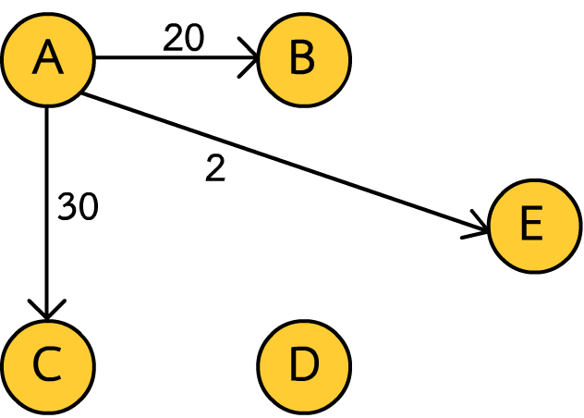
Build graph (each node)
Node a('A');
Node b('B');
Node c('C');
Node d('D');
Node e('E');
a.add_edge(20,&b);
a.add_edge(2 ,&e);
a.add_edge(30,&c);
Now only one way

Slide 14
Build graph
a.add_edge(20,&b);
a.add_edge(2 ,&e);
a.add_edge(30,&c);
b.add_edge(20,&a);
b.add_edge(7 ,&d);
b.add_edge(6 ,&e);
c.add_edge(30,&a);
c.add_edge(1 ,&e);
c.add_edge(2 ,&d);
d.add_edge(2 ,&c);
d.add_edge(7 ,&b);
d.add_edge(4 ,&e);
e.add_edge(6 ,&b);
e.add_edge(2 ,&a);
e.add_edge(1 ,&c);
e.add_edge(4 ,&d);

Slide 15
Print graph (node)
void print(){ // method in node
cout << data << "-> ";
for(int i=0;i<edge_count;i++){
cout << "(" << edges[i]->cost <<","<< (edges[i]->node)->data << ")";
}
cout << endl;
}
Result :
A-> (20,B)(2,E)(30,C)
B-> (20,A)(7,D)(6,E)
C-> (30,A)(1,E)(2,D)
D-> (2,C)(7,B)(4,E)
E-> (6,B)(2,A)(1,C)(4,D)
a.print();
b.print();
c.print();
d.print();
e.print();

Slide 16
Result :
A-> (20,B)(2,E)(30,C)
B-> (20,A)(7,D)(6,E)
C-> (30,A)(1,E)(2,D)
D-> (2,C)(7,B)(4,E)
E-> (6,B)(2,A)(1,C)(4,D)

Slide 17
Access
- Can start from any node / สามารถเริ่มใช้จาก node ใดก็ได้
Result :
A-> (20,B)(2,E)(30,C)
B-> (20,A)(7,D)(6,E)
C-> (30,A)(1,E)(2,D)
D-> (2,C)(7,B)(4,E)
E-> (6,B)(2,A)(1,C)(4,D)

Slide 18
example
A-> (20,B)(2,E)(30,C)
B-> (20,A)(7,D)(6,E)
C-> (30,A)(1,E)(2,D)
D-> (2,C)(7,B)(4,E)
E-> (6,B)(2,A)(1,C)(4,D)
How much total cost for this path from A to E
cout << a.edges[0]->cost + b.edges[1]->cost + d.edges[2]->cost << endl; // 31

Slide 19
example
A-> (20,B)(2,E)(30,C)
B-> (20,A)(7,D)(6,E)
C-> (30,A)(1,E)(2,D)
D-> (2,C)(7,B)(4,E)
E-> (6,B)(2,A)(1,C)(4,D)
How much total cost for this path from A to E
cout << a.edges[0]->cost + b.edges[2]->cost << endl; // 26

Slide 20
example
A-> (20,B)(2,E)(30,C)
B-> (20,A)(7,D)(6,E)
C-> (30,A)(1,E)(2,D)
D-> (2,C)(7,B)(4,E)
E-> (6,B)(2,A)(1,C)(4,D)
How much total cost for this path from A to E
cout << a.edges[1]->cost << endl; // 2

Slide 21
End of graph structure
Happy?

Slide 22
Quiz
Shortest path?

Slide 23
Why graph
- more flexible than tree
- more complex algorithm implementation***
- seem like realistic modelling (such as networking traffic)
- ยืดหยุ่นกว่า tree
- สามารถใช้ algorithm ที่ซับซ้อนได้มากกว่า***
- สามารถ modeling ให้เหมือนกันความเป็นจริงได้ เช่น networking การจราจร

Slide 24
Example program
- second order visited
List all possibility node that can visit with in 2 move
แสดง node ทั้งหมดที่เป็นไปได้ ที่สามารถเข้าถึงได้ด้วยการเดิน 2 ครั้ง

Slide 25

Remark ***
- following algorithm is just a partial algorithm can’t use in real life application
- algorithm ต่อไปนี้เป็นเพียงส่วนหนึ่งของ algorithm เท่านั้นไม่สามารถนำไปใช้จริงได้

Slide 26
second order visited
void second_order_visited(Node* n){
for(int i = 0;i<n->edge_count;i++){ // like print
Node* node1 = (n->edges[i])->node;
int cost1 = (n->edges[i])->cost;
for(int j=0;j<node1->edge_count;j++){
Node* node2 = (node1->edges[j])->node;
int cost2 = cost1 + (node1->edges[j])->cost;
cout << n->data << "->" << node1->data << "->" << node2->data << " = " << cost2 << endl;
}
}
}

Slide 27
second order visited
second_order_visited(&a);
A->B->A = 40
A->B->D = 27
A->B->E = 26
A->E->B = 8
A->E->A = 4
A->E->C = 3
A->E->D = 6
A->C->A = 60
A->C->E = 31
A->C->D = 32

Slide 28
third order visited
void third_order_visited(Node* n){
for(int i = 0;i<n->edge_count;i++){ // like print
Node* node1 = (n->edges[i])->node;
int cost1 = (n->edges[i])->cost;
for(int j=0;j<node1->edge_count;j++){
Node* node2 = (node1->edges[j])->node;
int cost2 = cost1 + (node1->edges[j])->cost;
for(int k=0;k< node2->edge_count;k++){
Node* node3 = (node2->edges[k])->node;
int cost3 = cost2 + (node2->edges[k])->cost;
cout << n->data << "->" << node1->data << "->" << node2->data << "->" << node3->data << " = " << cost3 << endl;
}
}
}
}

Slide 29
third order visited
A->C->E->D = 35
A->C->D->C = 34
A->C->D->B = 39
A->C->D->E = 36
A->B->A->B = 60
A->B->A->E = 42
A->B->A->C = 70
A->B->D->C = 29
A->B->D->B = 34
A->B->D->E = 31
A->B->E->B = 32
A->B->E->A = 28
A->B->E->C = 27
A->B->E->D = 30
A->E->B->A = 28
A->E->B->D = 15
A->E->B->E = 14
A->E->A->B = 24
A->E->A->E = 6
A->E->A->C = 34
A->E->C->A = 33
A->E->C->E = 4
A->E->C->D = 5
A->E->D->C = 8
A->E->D->B = 13
A->E->D->E = 10
A->C->A->B = 80
A->C->A->E = 62
A->C->A->C = 90
A->C->E->B = 37
A->C->E->A = 33
A->C->E->C = 32

Slide 30
Forth? Fifth? Sixth?
n order visited = graph traversal
- inorder
- postorder
- preorder

Slide 31
nearest neighbor graph
- find nearest node (in first order)
- หา node ที่อยู่ใกล้ที่สุด (ใน first order)
Who is nearest node of ‘B’ ?
ใครอยู่ใกล้ B ที่สุด ?

Slide 32
Code
Node* nearest_node(Node* n){
int nearest_idx = 0;
for(int i=0;i<n->edge_count;i++){
if(n->edges[i]->cost < n->edges[nearest_idx]->cost){
nearest_idx = i;
}
}
return n->edges[nearest_idx]->node;
}
*Like find minimum number in set

Slide 33
Code
cout << "nearest node of A is " << nearest_node(&a)->data << endl;
cout << "nearest node of B is " << nearest_node(&b)->data << endl;
cout << "nearest node of C is " << nearest_node(&c)->data << endl;
cout << "nearest node of D is " << nearest_node(&d)->data << endl;
cout << "nearest node of E is " << nearest_node(&e)->data << endl;
Result :
nearest node of A is E
nearest node of B is E
nearest node of C is E
nearest node of D is C
nearest node of E is C

Slide 34
question
- what is the shortest path between node x and y with exact 3 move
- เส้นทางใหนที่สั้นที่สุดระหว่าง node x และ y หากกำหนดให้ต้องเดินทั้งหมด 3 ครั้ง

Slide 35
Brute force algorithm
- travel to the z order visited and collect minimum cost
- ท่อง node โดยใช้วิธี z order visited และเก็บวิธีที่ cost น้อยที่สุด
What if sixth order Really !!?

Slide 36
Easy question (if third order)
- Traversal in third order visited method and collect minimum cost visited node
- ใช้วิธี third order visited และเก็บครั้งที่ใช้ cost น้อยที่สุด

Slide 37
code
int third_shortest_path(Node* n, char target){
int min_cost = -1;
for(int i = 0;i<n->edge_count;i++){ // like print
Node* node1 = (n->edges[i])->node;
int cost1 = (n->edges[i])->cost;
for(int j=0;j<node1->edge_count;j++){
Node* node2 = (node1->edges[j])->node;
int cost2 = cost1 + (node1->edges[j])->cost;
for(int k=0;k< node2->edge_count;k++){
Node* node3 = (node2->edges[k])->node;
int cost3 = cost2 + (node2->edges[k])->cost;
if(node3->data == target){
if(min_cost == -1 || cost3 < min_cost){
min_cost = cost3;
}
}
}
}
}
return min_cost;
}

Slide 38
code
cout << "Shortest from A to E is cost " << third_shortest_path(&a, 'E') << endl;
cout << "Shortest from A to C is cost " << third_shortest_path(&a, 'C') << endl;
cout << "Shortest from B to C is cost " << third_shortest_path(&b, 'C') << endl;
cout << "Shortest from A to B is cost " << third_shortest_path(&a, 'B') << endl;
Shortest from A to E is cost 4
Shortest from A to C is cost 8
Shortest from B to C is cost 12
Shortest from A to B is cost 13

Slide 39
What is big theta for third shortest path
- n^3 !!??

Slide 40
Challenge question
- what is the shortest path between node x and y in z move
- เส้นทางใหนที่สั้นที่สุดระหว่าง node x และ y หากกำหนดให้เดินได้ z ครั้ง

Slide 41
What is big theta for n path
- n^n !!??

Slide 42
Dijkstra's algorithm
O(n log n) where n is the number of vertices
https://en.wikipedia.org/wiki/Dijkstra%27s_algorithm

Slide 43
Conclude
- Component of graph
- fundamental graph algorithm

